Slide 1
Become (Power)Shell Ninja Today
Bartek Bielawski

Slide 2

Many thanks to our sponsors:

Slide 3
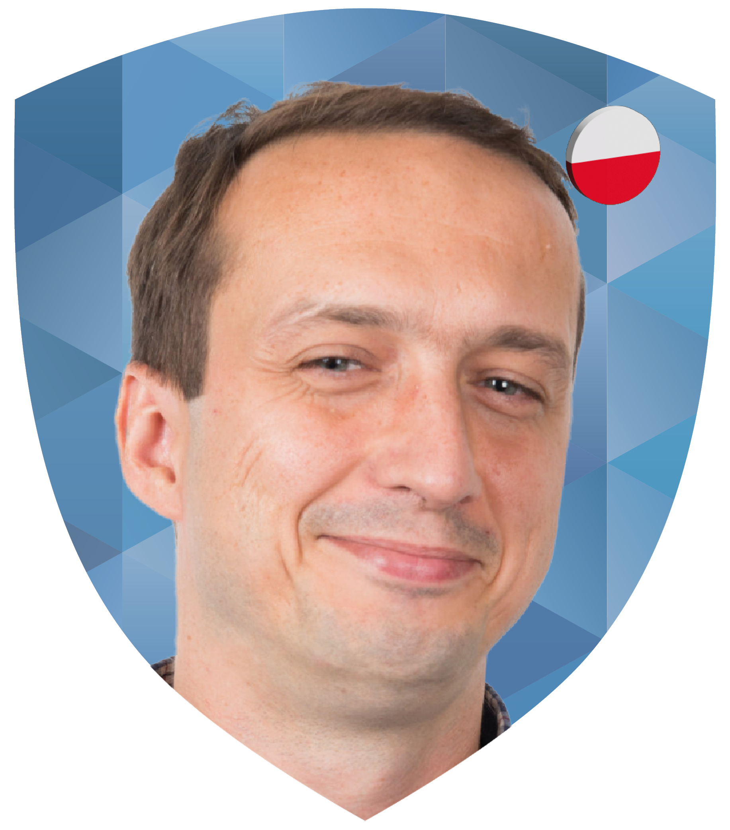
Bartek Bielawski
Author/ blogger/ speaker
Working for Optiver (NL)
Former PowerShell MVP

Slide 4
Demos
We love Demos!

Slide 5
Q&A
15 minutes

